Slide 1

Toolkit Doc18 Laser sled
May 7, 2010

Slide 2
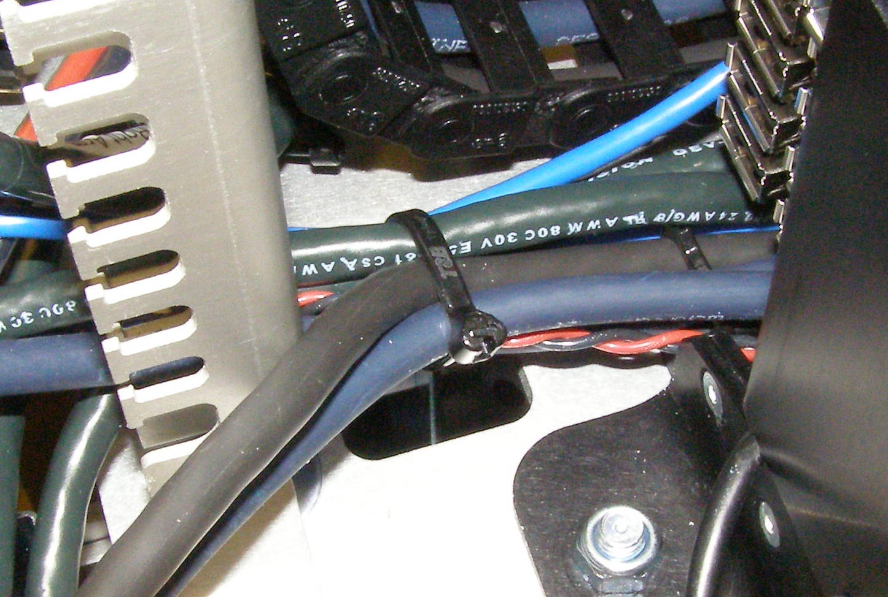
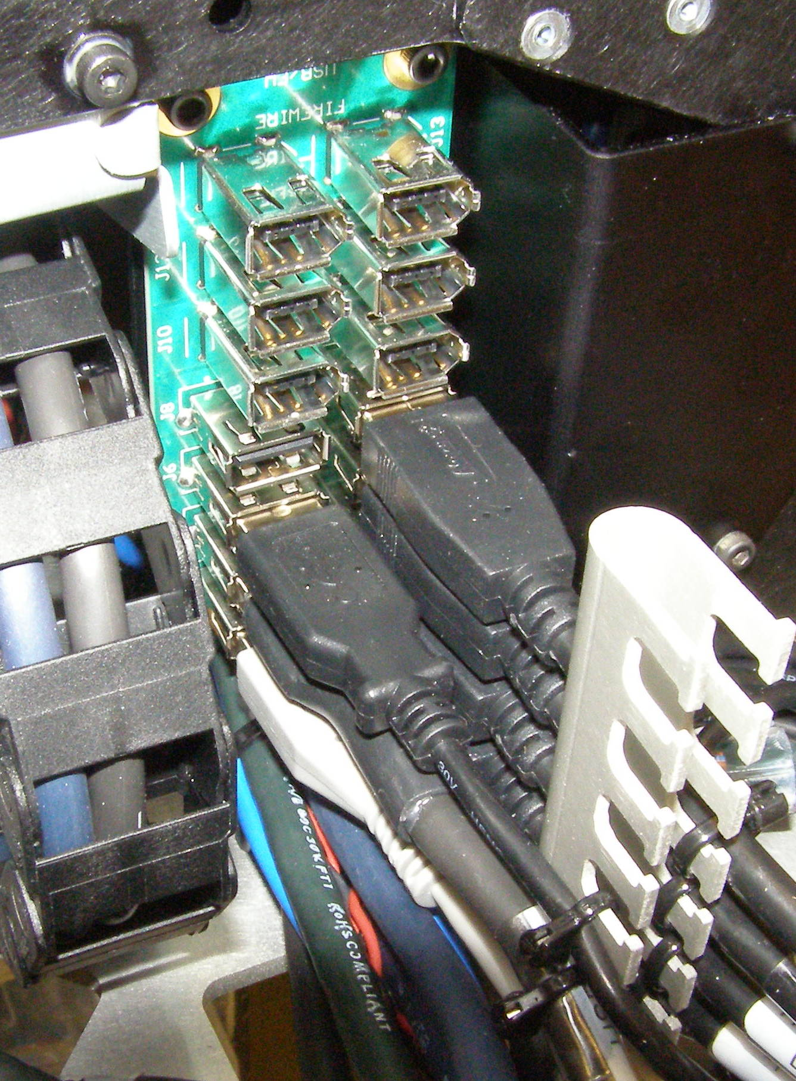
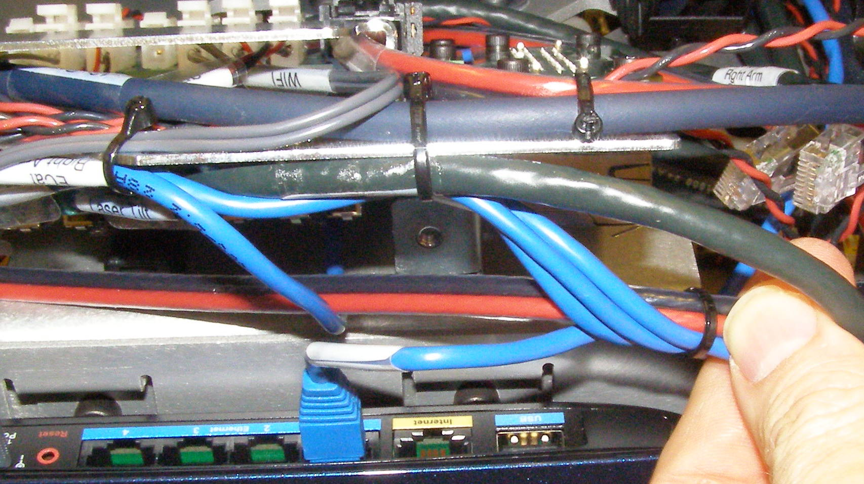
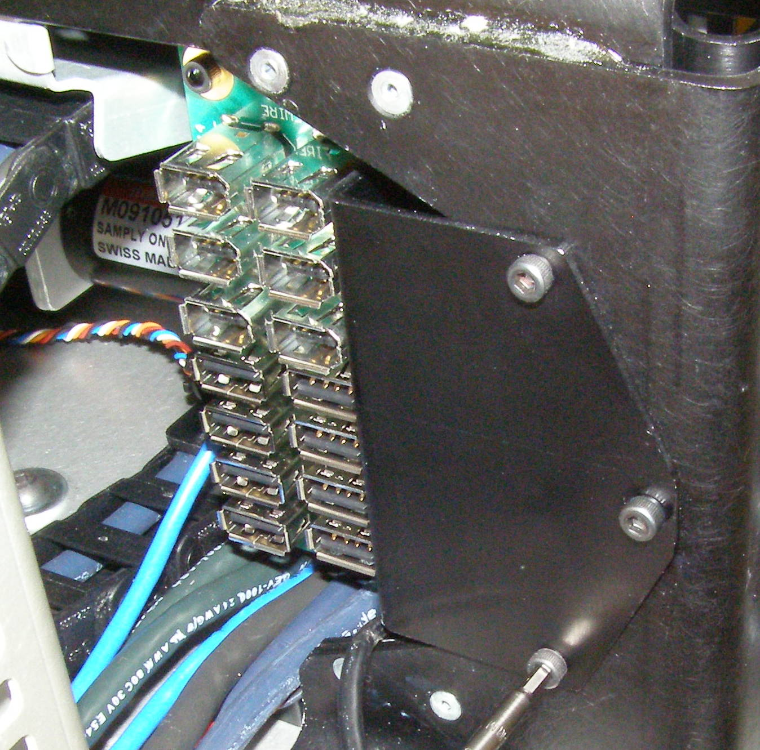
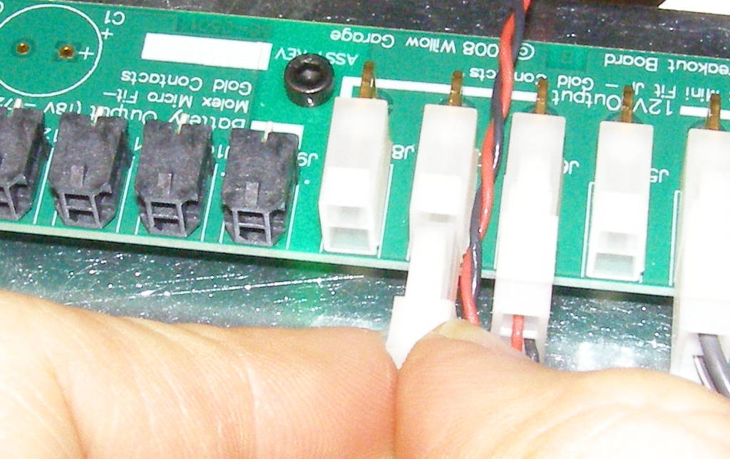
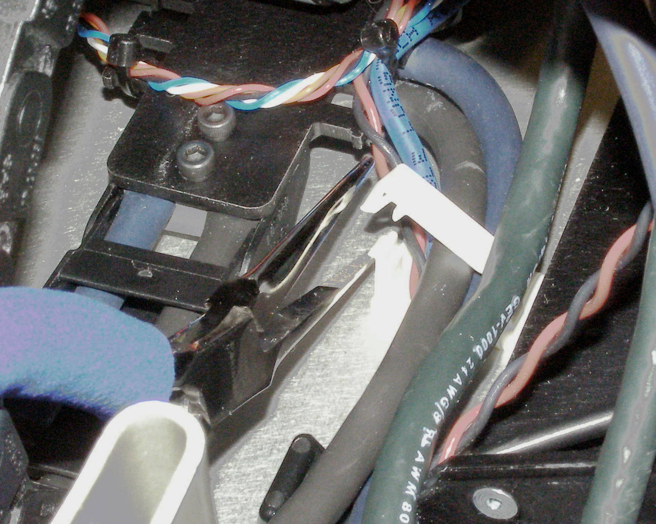
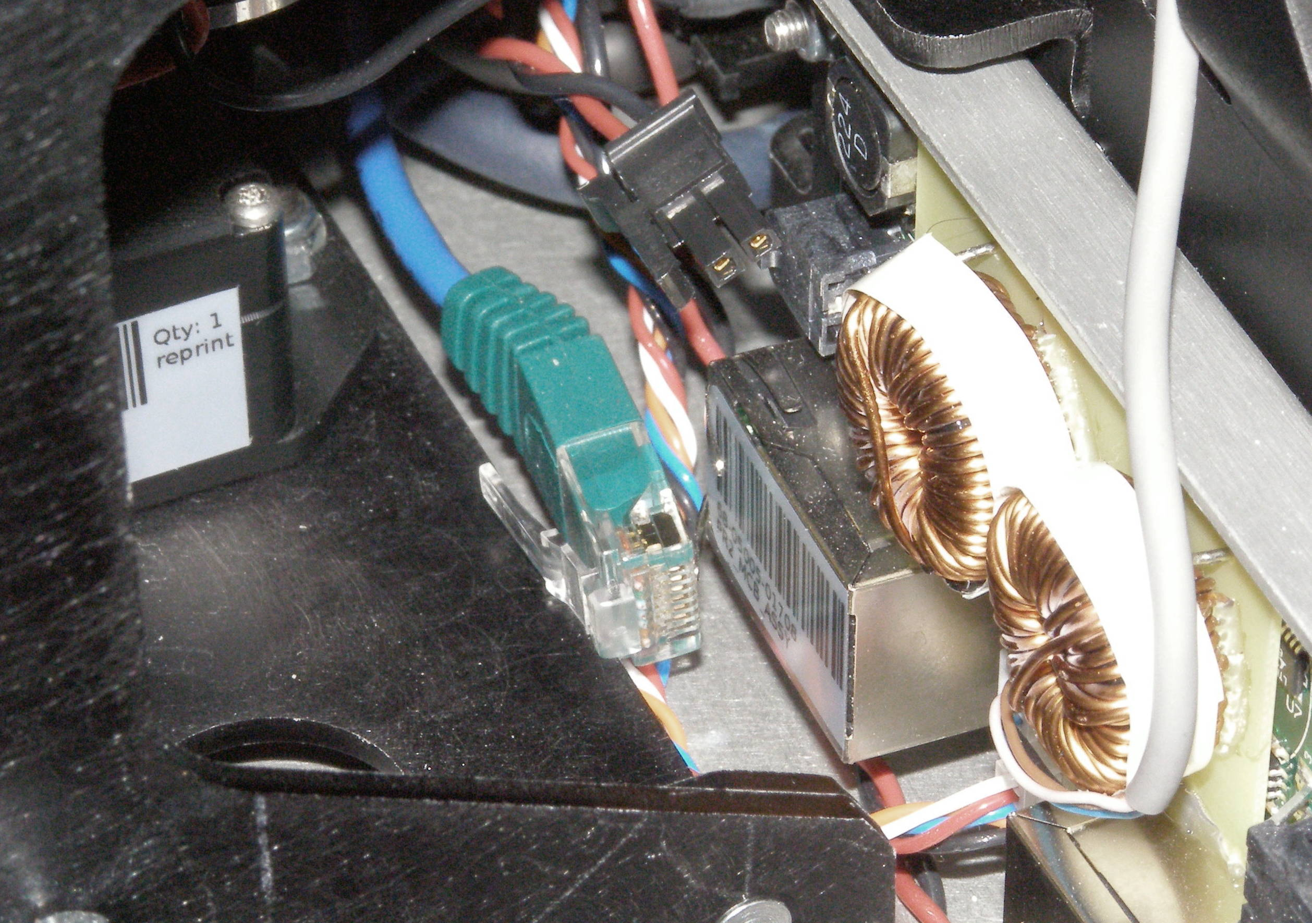
Laser sled Removal (1)
Laser Sled, Removal - 4001
  Remove Front and Rear Top Covers.
  Using small diagonal wire cutters, (not supplied) cut the zip-ties and unplug 7 USB cables (Fig 1)
  Using the 2.5mm bit with the T-handle driver, remove the 3 screws retaining the USB Hub Assembly. 2009-06 (Fig 2)
  Using the Needle Nose pliers, unsnap the White cable clamp next to the Laser Sled echain. (Fig 3)
  Cut zip-ties. (Fig 4,5)
  Unplug “12v Pwr Head Laser” cable (Fig 6)
  Unplug the Ethercat and MCB power cables. (Fig 7)
Fig 1
Fig 4
Fig 5
Fig 5
Fig 2
Fig 6
Fig 3
Fig 4
Fig 3
Fig 7

Slide 3
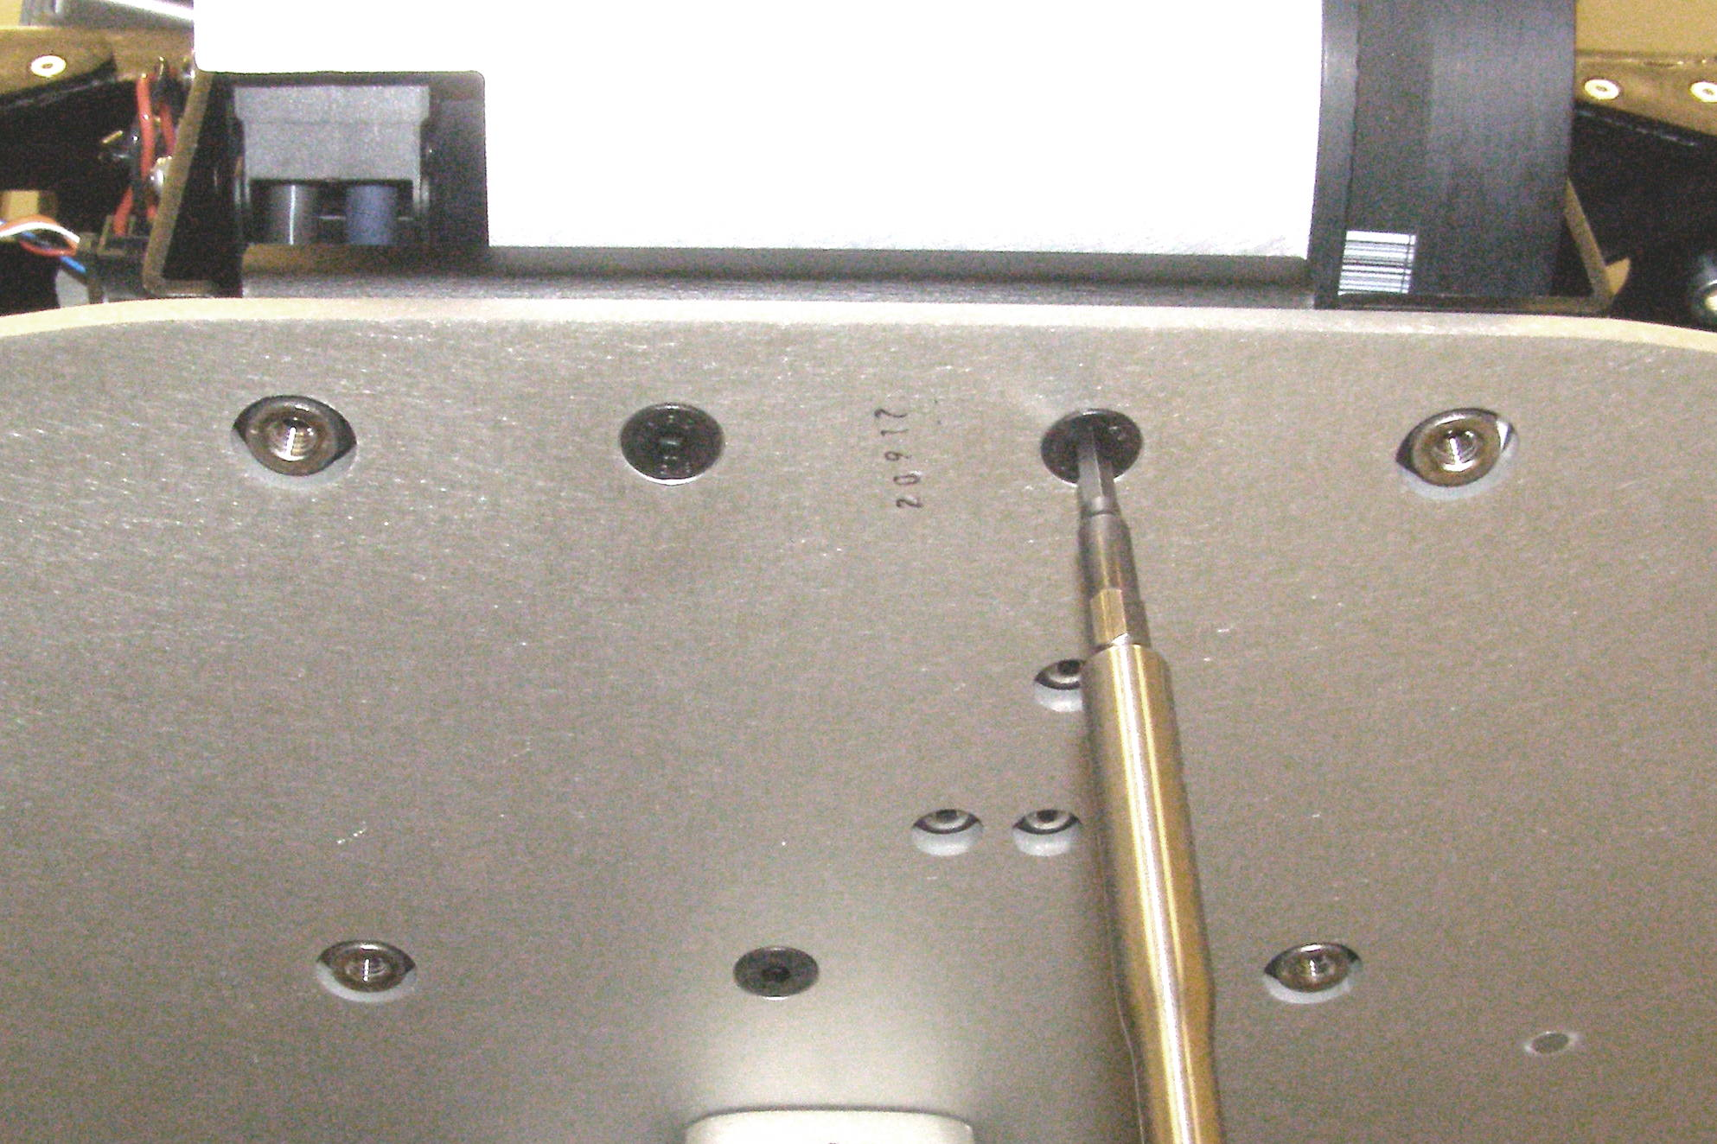
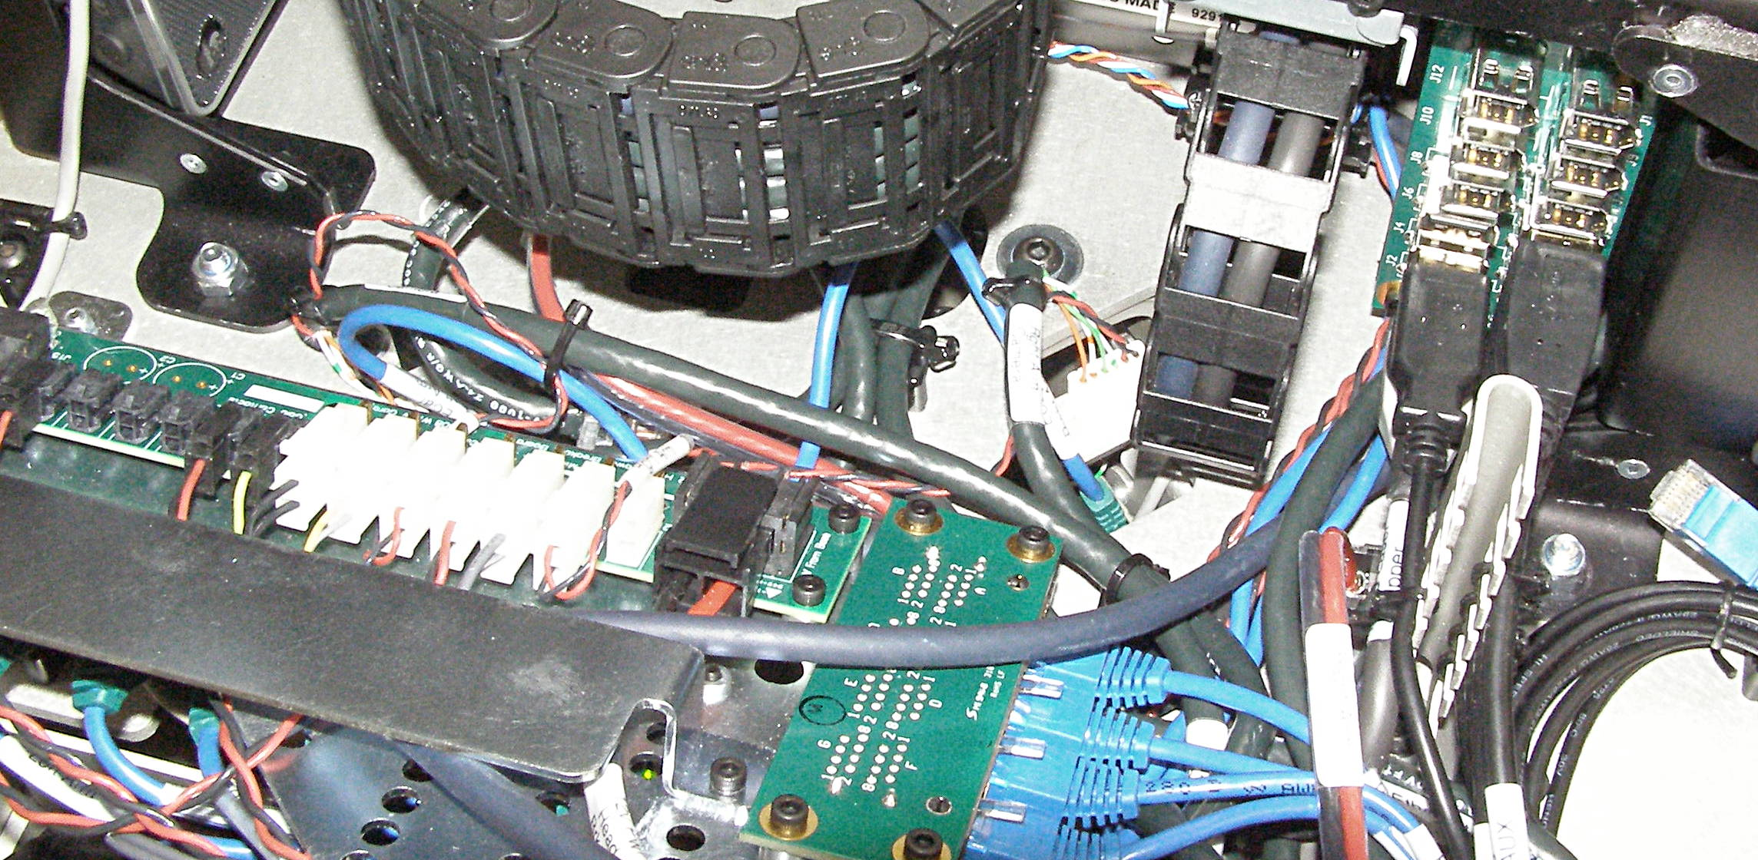
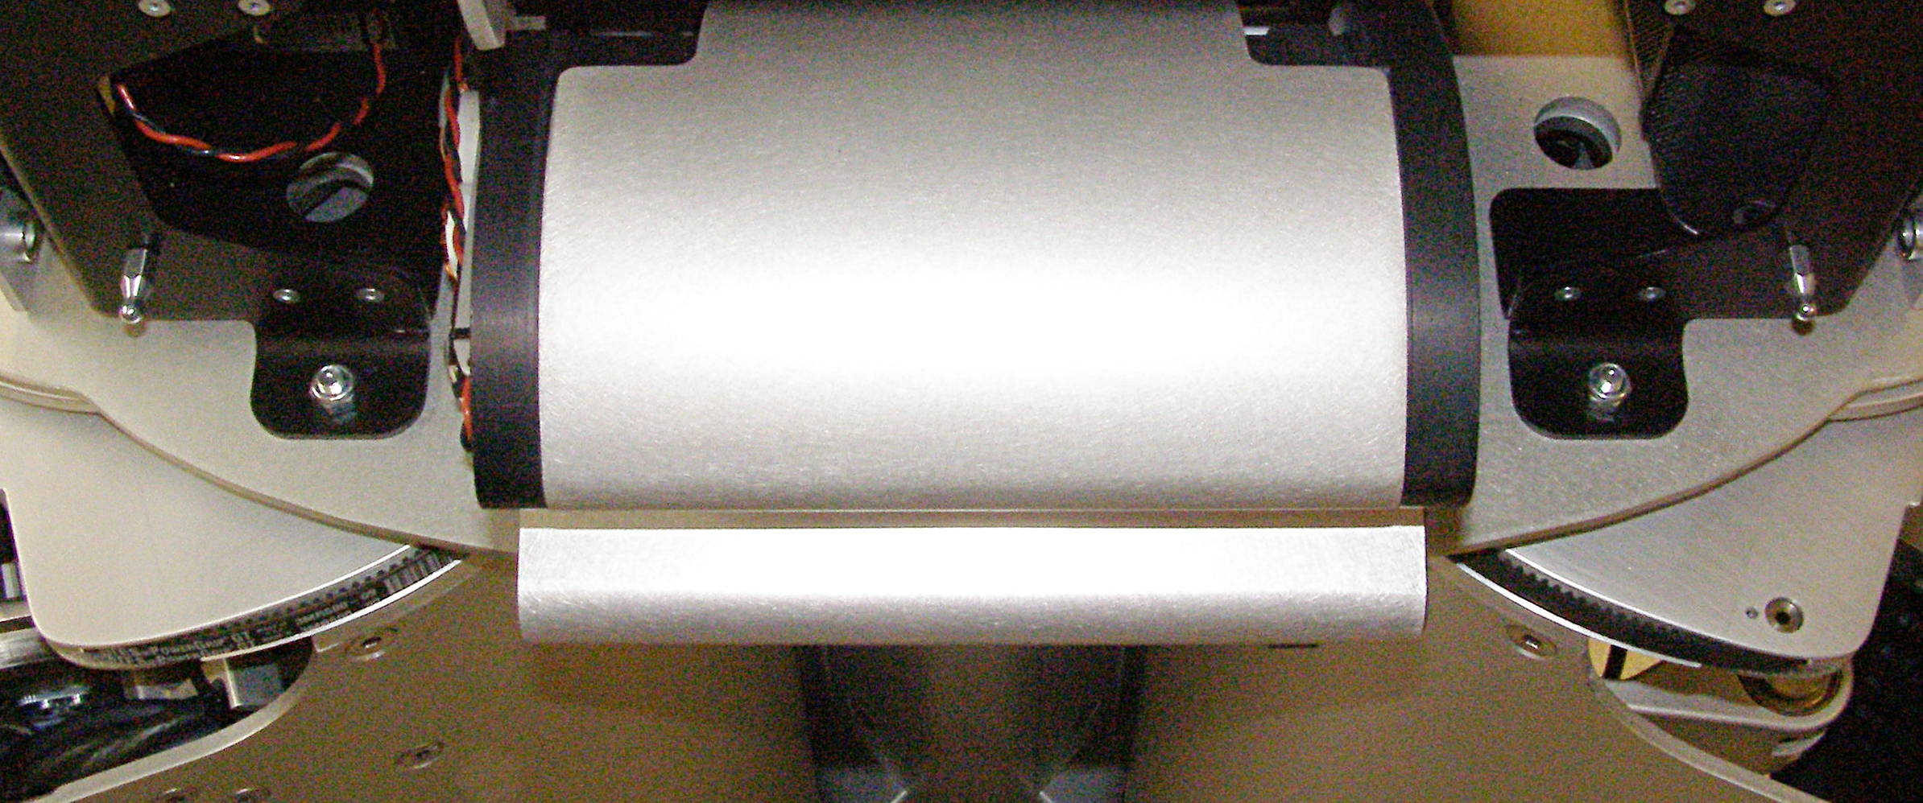
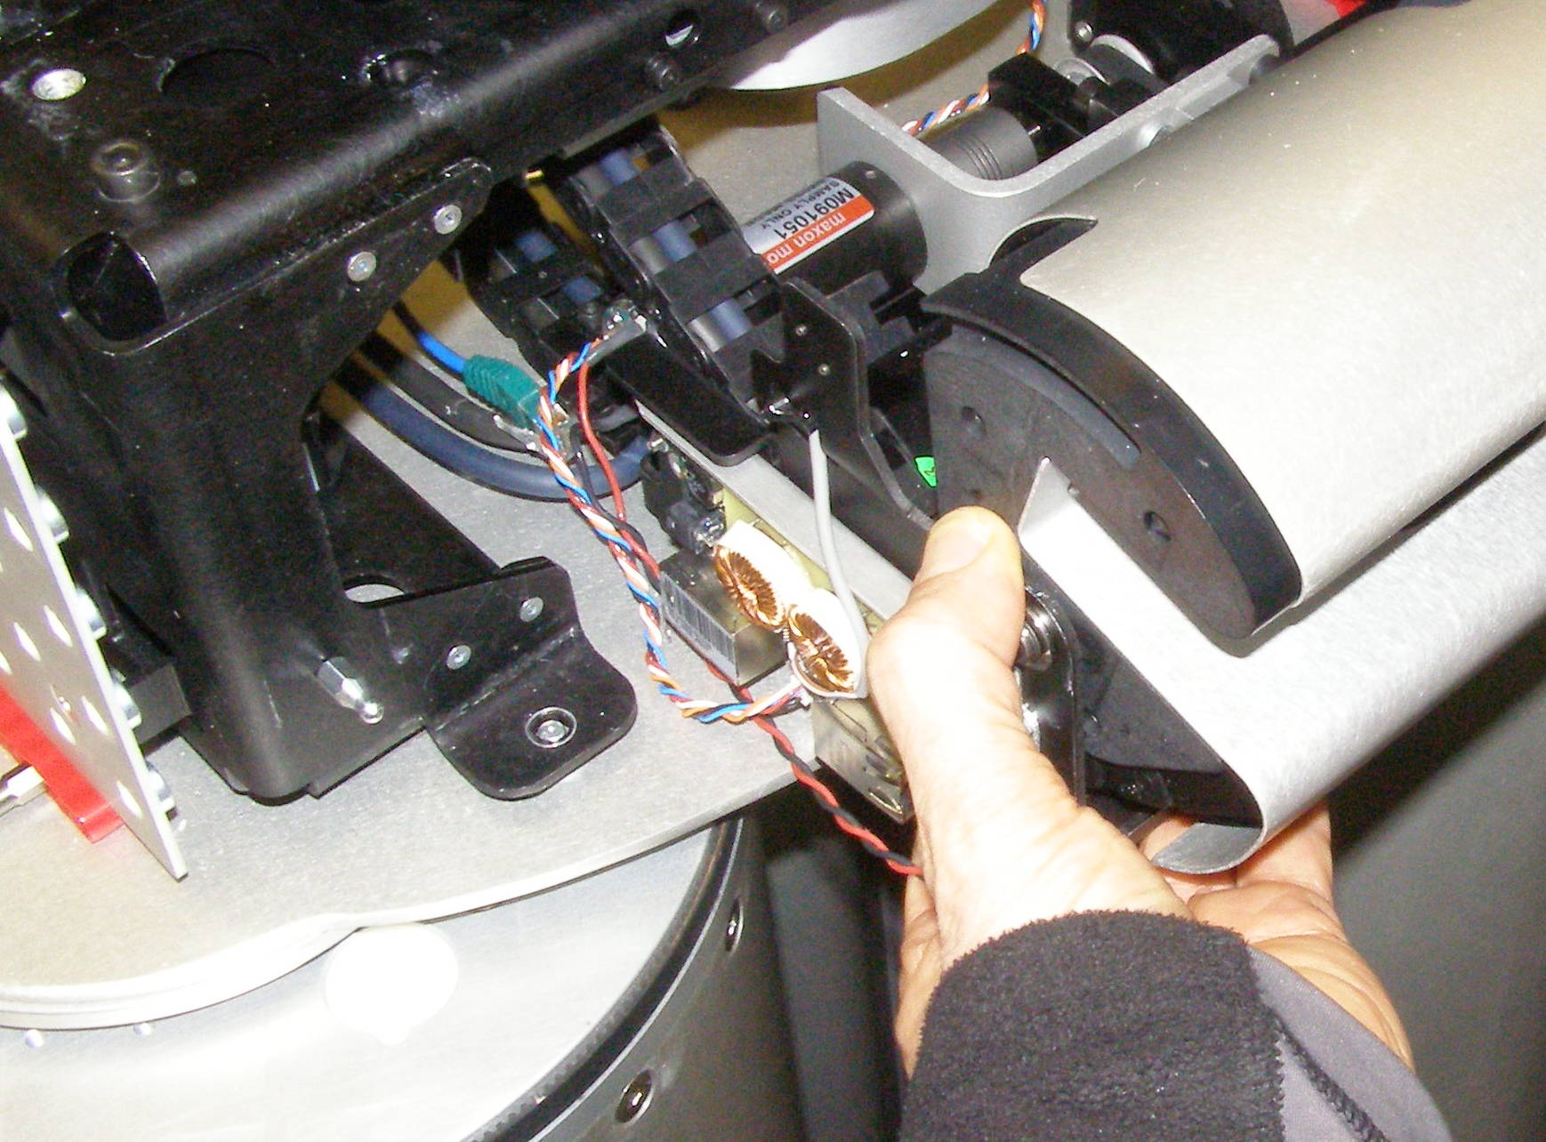
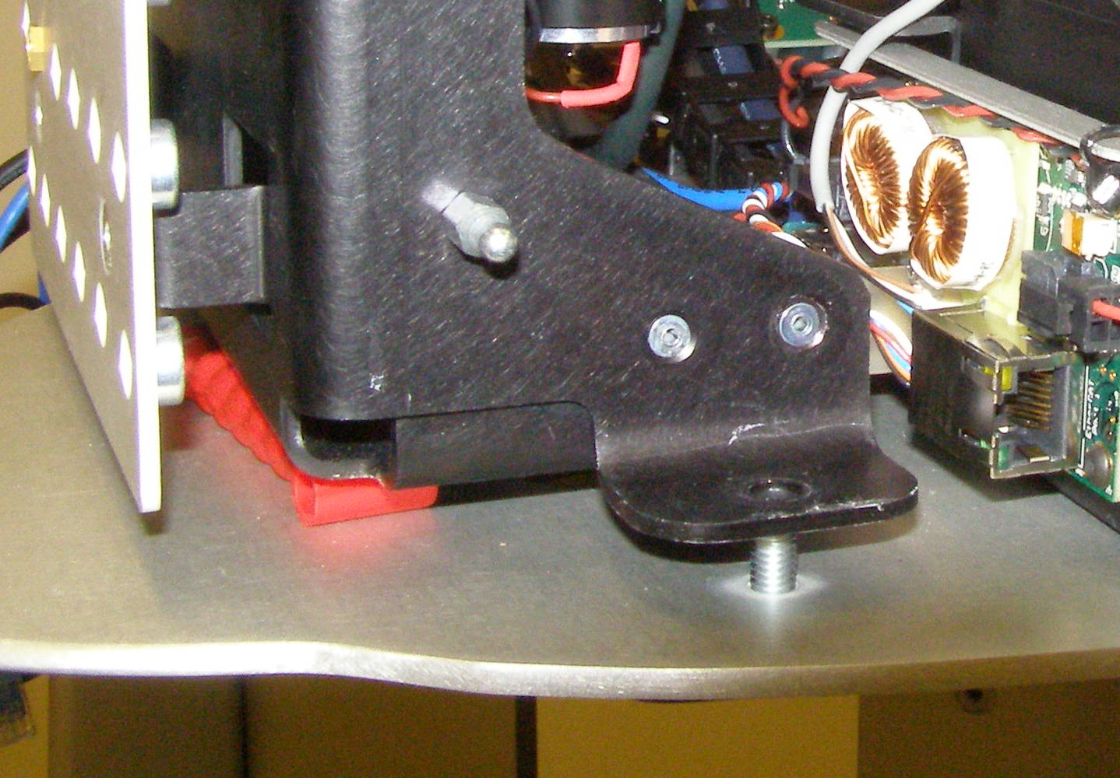
Laser Sled Removal (2)
  Using the 10mm 3/8 drive socket, and the 3/8 extension, and the 3/8 drive ratchet wrench, remove the 4 Head mounting nuts. 1134
  (Fig 8,9)
  Raise the Head assembly about 1cm. The Tool bit holders will work adequately as spacers. (Fig 10)
  Using the 4mm bit with the T-handle driver, remove the 3 Flathead screws. (Fig 12)
  Lifting the Laser Sled assembly about 1cm to clear the PEM's on the bottom, slide the assemble out of the front being careful not to snag any cables. (Fig 12,13)
Fig 12
PEM
PEM
Fig 8
Fig 9
Fig 13
Fig 10

Slide 4
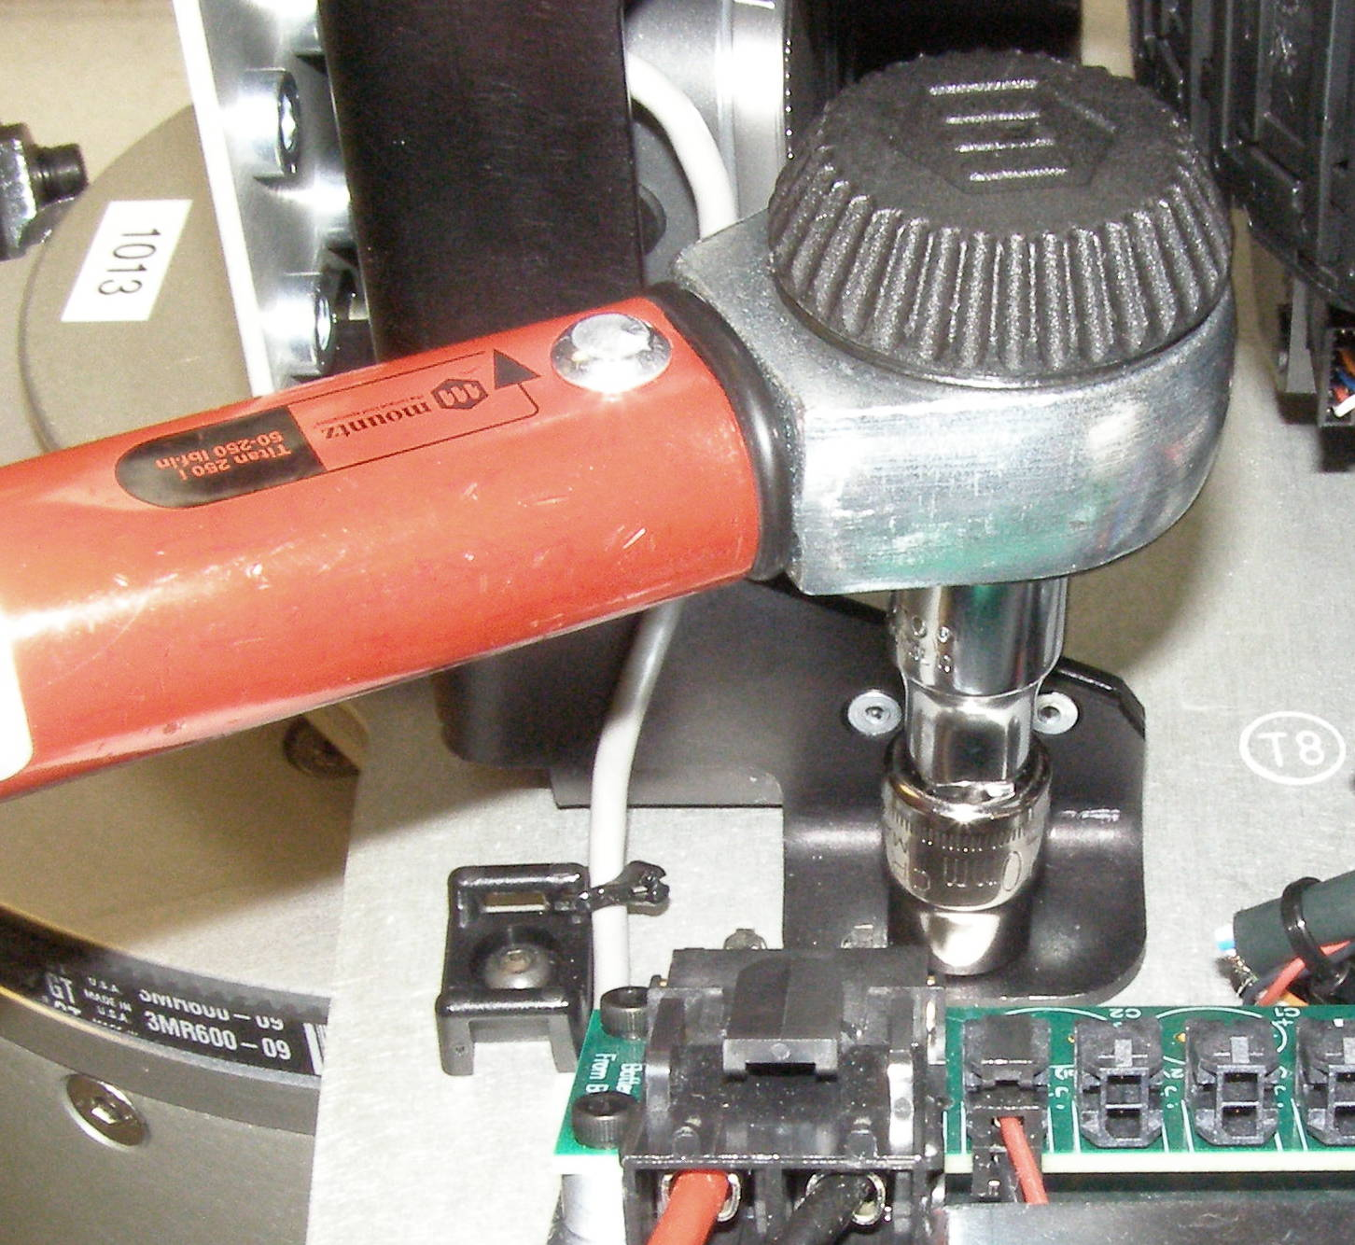
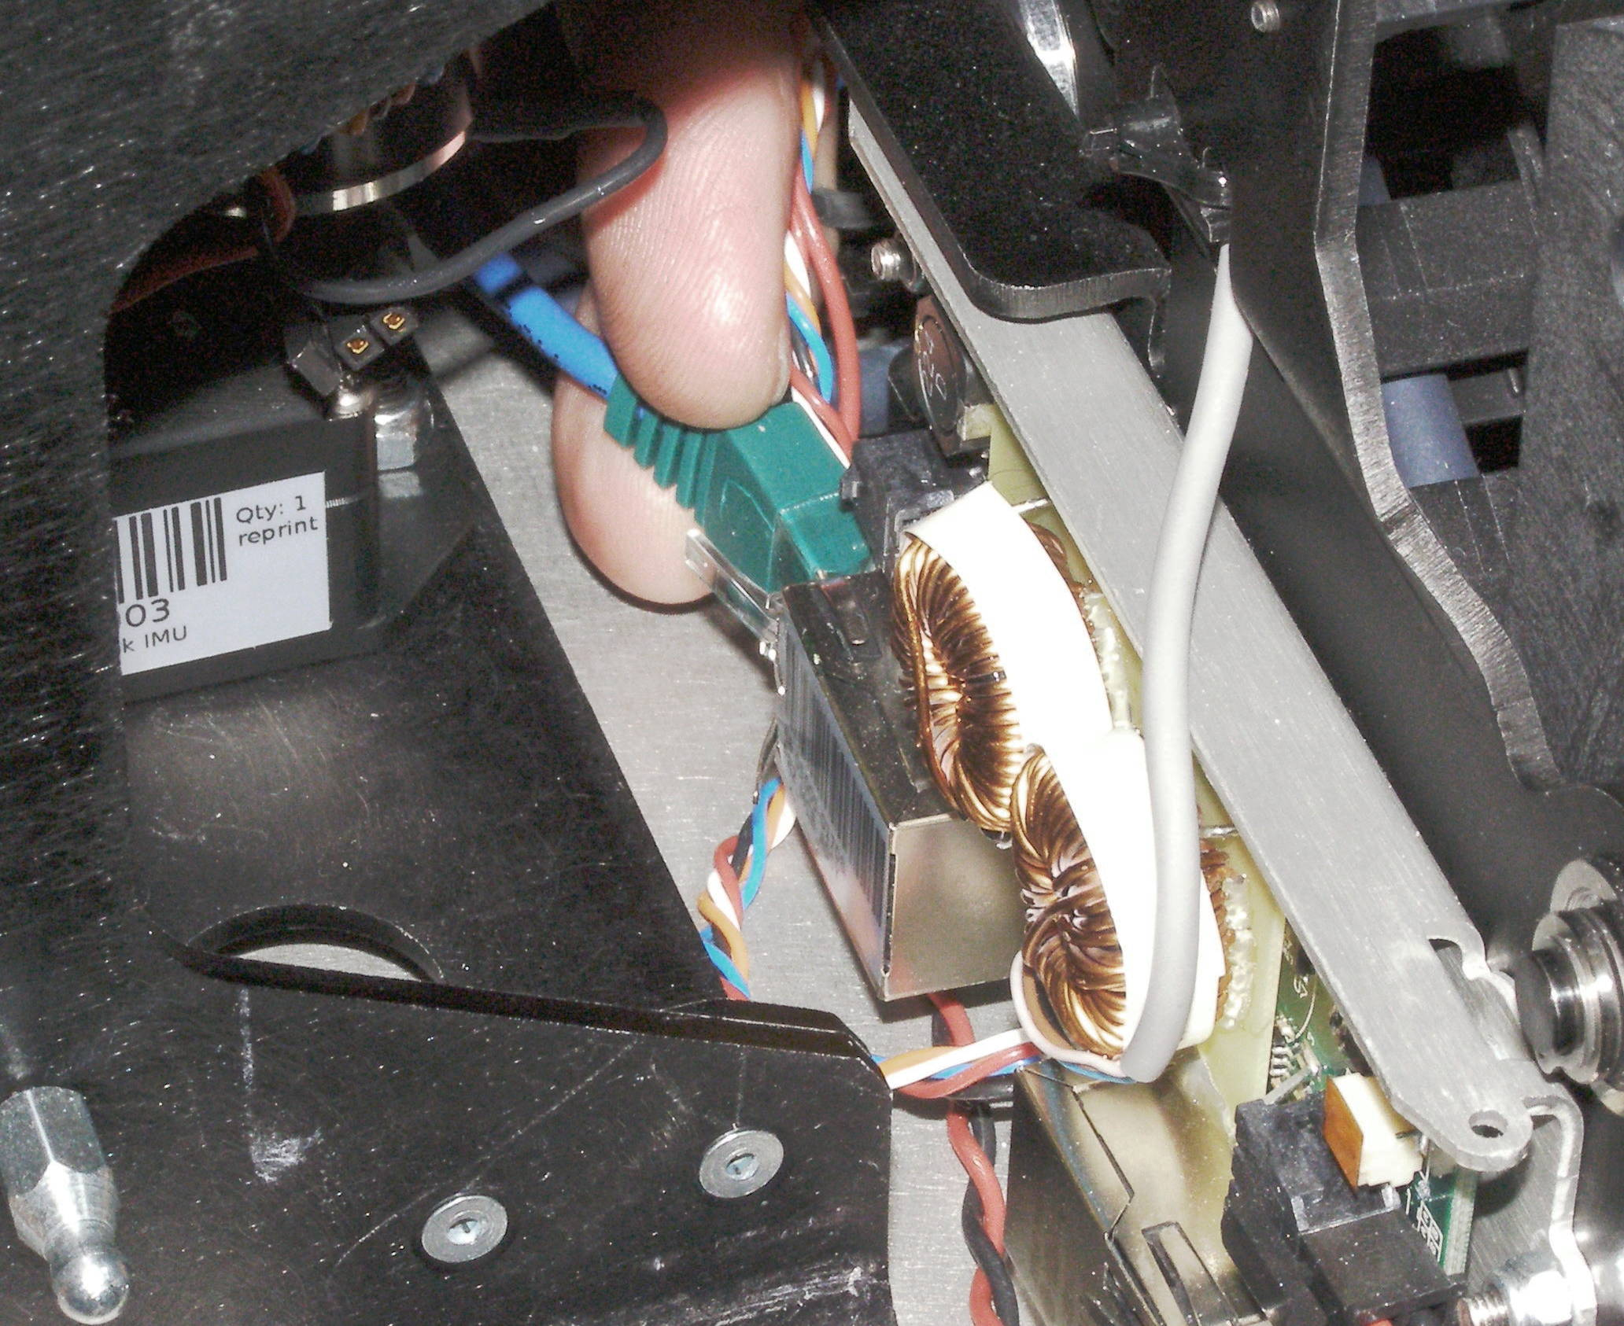
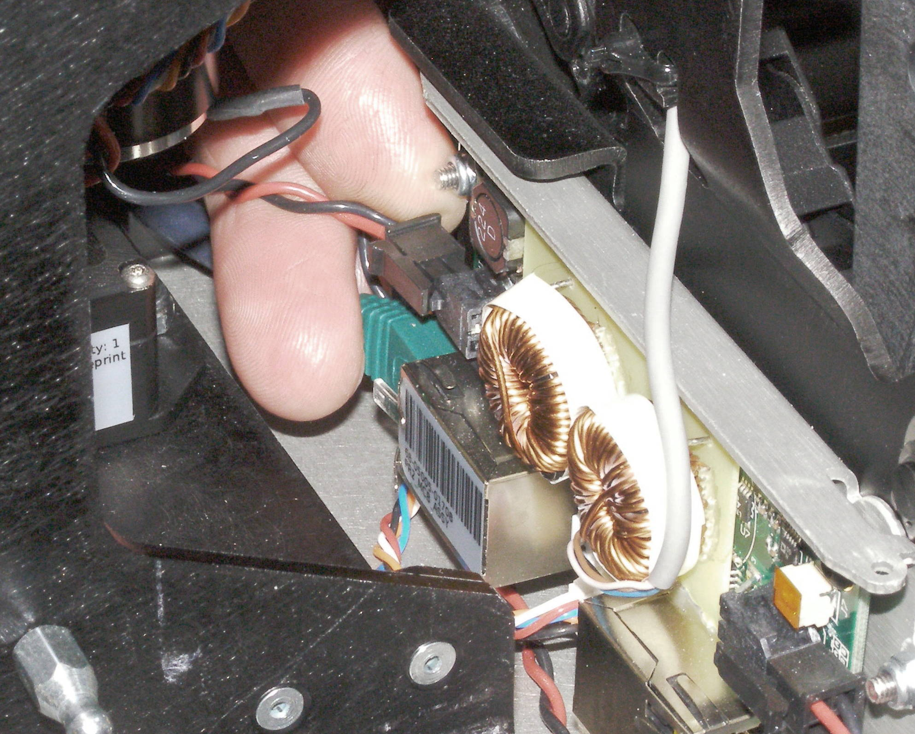
Laser sled Install
Laser Sled, Install
  Slide the Laser Sled back into place being careful that the PEMS clear the base plate.
  Reaching through from the rear, plug in the EtherCAT and MCB Power connectors.
  (Fig 1,2)
  Remove the spacers and lower the Head assembly.
  Install the 4 nuts and torque to 11Nm using the Titan Torque wrench together with the 3/8 extension and the 10mm socket. (Fig 3)
Fig 3
Fig 1
  Using Loctite 248, install the 3 USB Hub Assembly mounting screws and torque to 1.36Nm using the Large torque driver.
  Reverse the remainder of the removal procedure adding zip-ties as needed to replace the cut ones.
  The connector order for the USB Hub is:
    Right, bottom – Speaker
    Right – Head Laser Lower
    Right – IMU Lower
    Right – Head Aux
    Left, bottom – Speaker (Gray)
    Left – Head Laser Upper
    Left – IMU
    Empty
Fig 2
Right
Top

